Slide 1

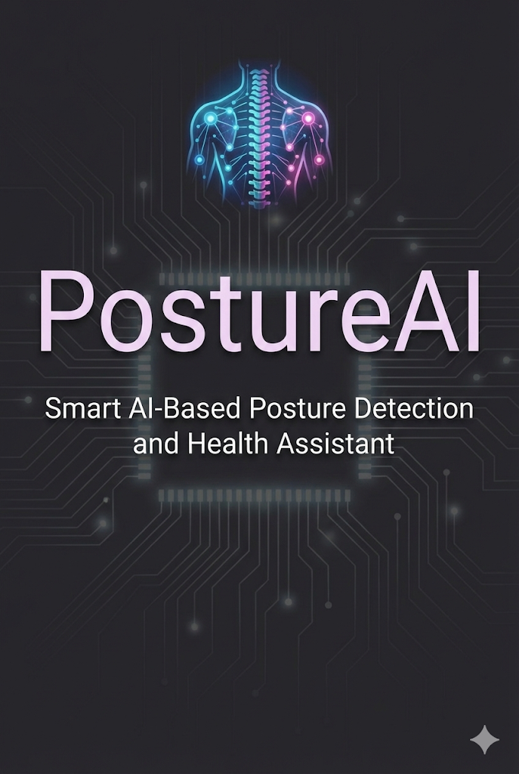
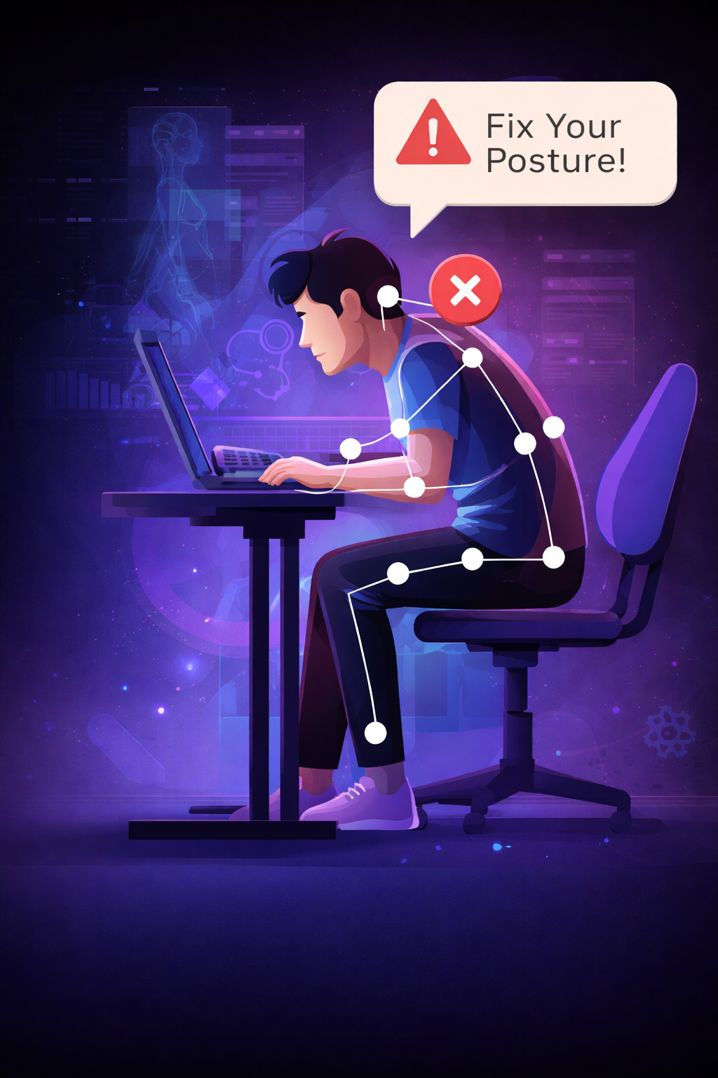
PostureAI
Smart AI-Based Posture Detection and Health Assistant
With Team CoDeX - (Shubham Shukla(leader), Aakash Rana ,
Farman Khan, TaraShankar hazra )

Slide 2
THE PROBLEM
The Silent Health Crisis Affecting Millions
The Reality
80%
54M
Students, software developers, and remote workers spend 8–12 hours daily in front of screens, often sitting in incorrect postures without realizing it. Continuous slouching, forward neck tilt, and improper chair or desk setup lead to chronic back pain, neck strain, eye fatigue, and long-term musculoskeletal disorders.
Most people only notice these issues after pain or injury occurs, because there is no real-time feedback system to correct posture during work or study. As digital screen time increases, posture-related health problems are becoming a silent epidemic among the young working population.
Office Workers
Days Lost
Experience neck or back pain annually
Due to musculoskeletal disorders each year
$50B
Annual Cost
In healthcare and lost productivity

Slide 3
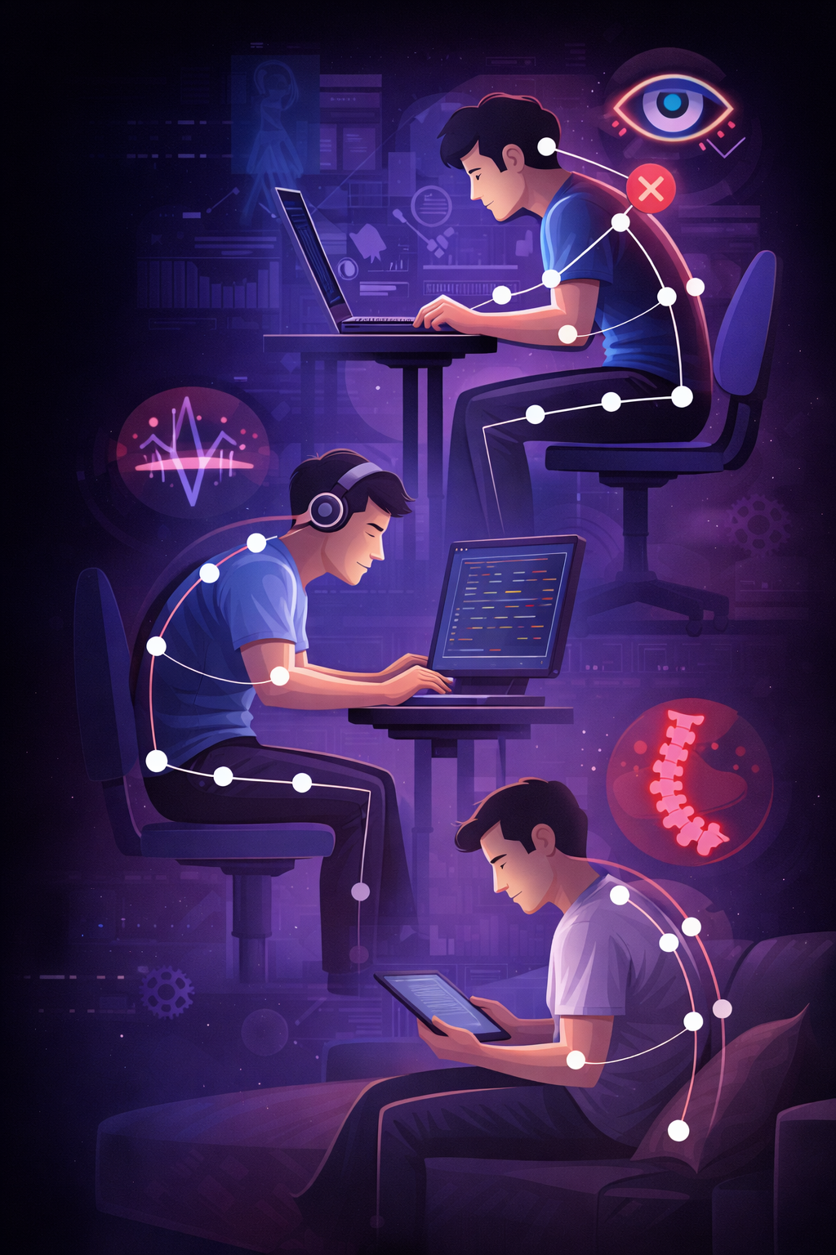
Why Traditional Solutions Fall Short
Wearable Devices
Expensive, uncomfortable for long-term wear, require charging, and often forgotten or ignored during busy work sessions.
Manual Reminders
Apps that send generic timed alerts without understanding actual posture quality or providing personalized feedback.
Ergonomic Furniture
Helps but doesn't prevent slouching or monitor real-time posture habits throughout the workday.

Slide 4

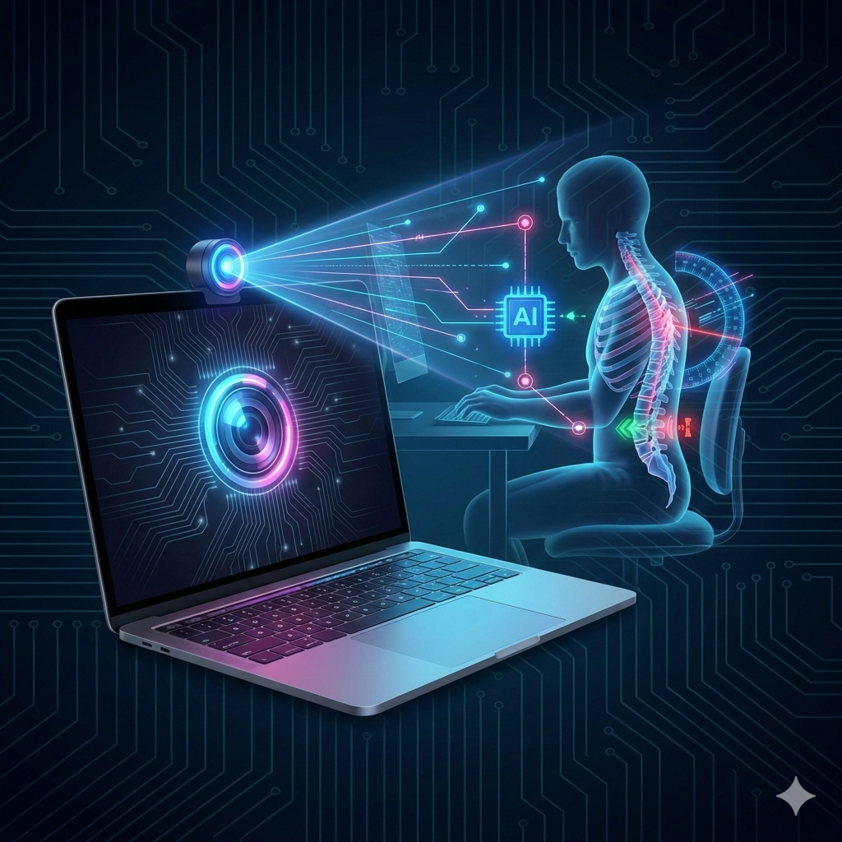
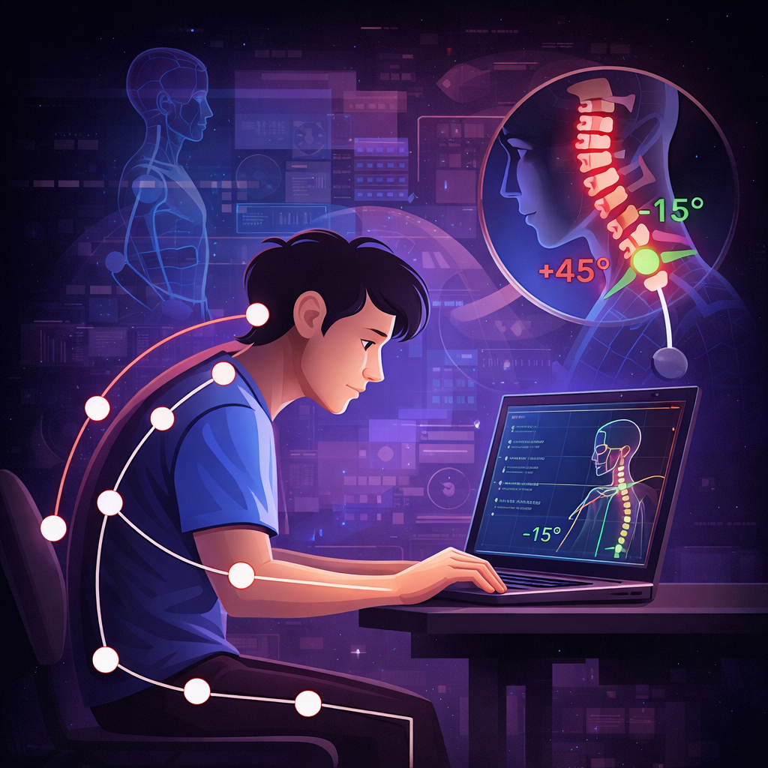
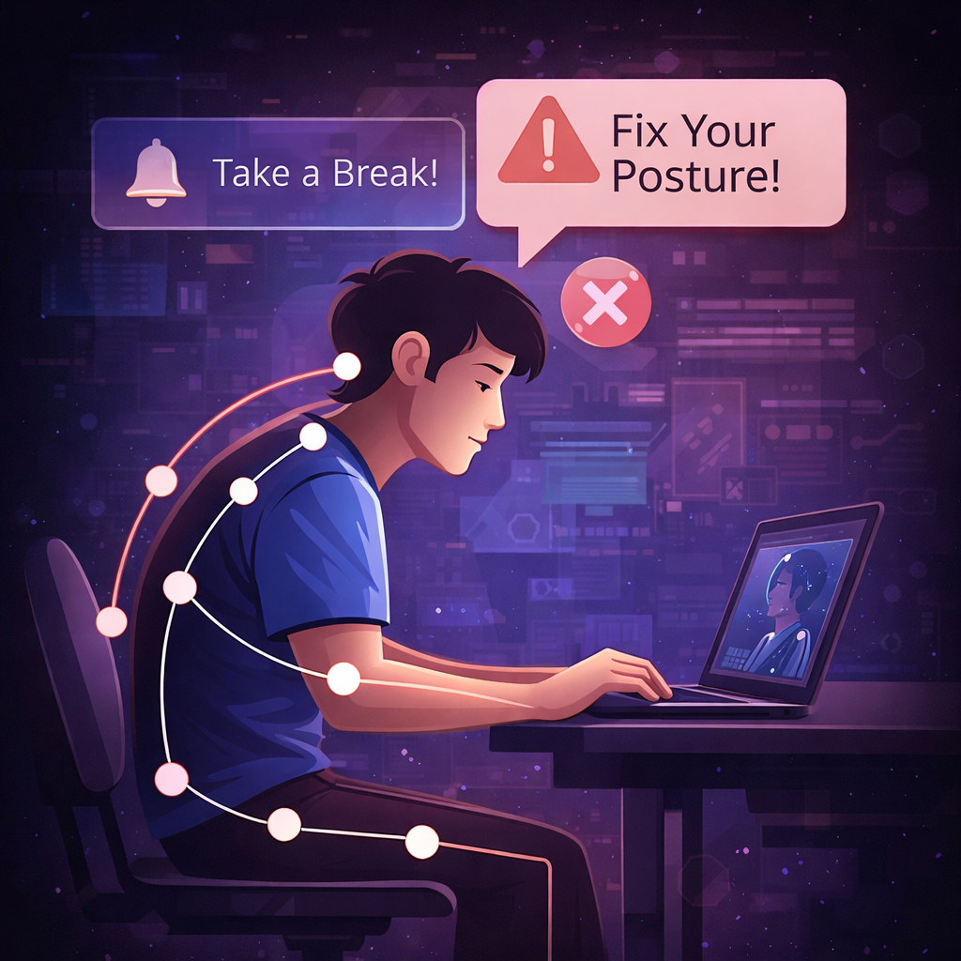

THE SOLUTION
Introducing PostureAI
An intelligent web application that uses your device camera and AI to detect posture in real time, providing instant feedback and personalized health insights , no wearables required.
Camera-Based Detection
Real-Time Analysis
Instant Alerts
Uses your existing device camera to monitor posture continuously without additional hardware.
AI analyzes spine and neck angles instantly, detecting poor posture before it causes pain.
Gentle notifications and break reminders help you correct posture and stay healthy.

Slide 5
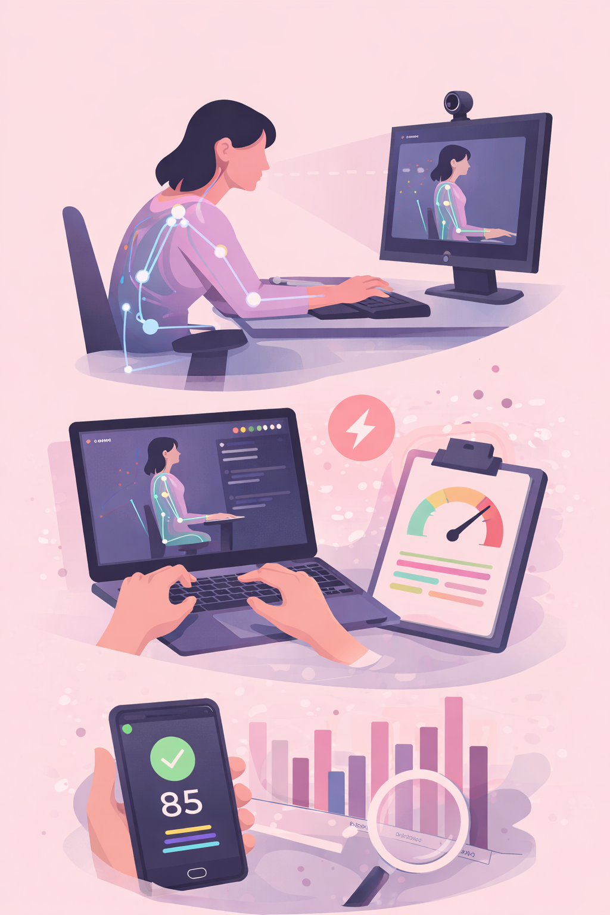




Innovation That Sets Us Apart
Zero Hardware
Real-Time Feedback
Personalized Score
No wearables, sensors, or special equipment—just your camera
Instant posture analysis with sub-second response times
Dynamic health score adapts to your unique posture patterns
Weekly Analytics
Comprehensive insights into your posture trends and improvements

Slide 6





TARGET MARKET
Who Benefits from PostureAI?
College Students
Software Developers
Long study sessions and online classes create posture challenges that affect focus and health.
Extended coding sessions demand posture monitoring to prevent long-term musculoskeletal disorders.
Remote Workers
Corporate Teams
Home office setups often lack ergonomic support, leading to chronic pain issues.
Companies seeking wellness solutions to reduce healthcare costs and boost employee productivity.
Market Opportunity: The remote work boom and rising musculoskeletal disorders create a $2.8B addressable market growing at 15% annually.

Slide 7

Technical Architecture
Built with modern web technologies and powered by Google's robust cloud infrastructure for reliability, scalability, and real-time performance.
Camera Input
Pose Detection
Posture Analysis
Cloud Services
Our architecture ensures seamless real-time processing with minimal latency, enabling instant feedback while maintaining user privacy through client-side AI processing.

Slide 8


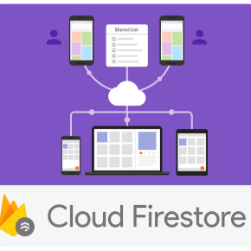
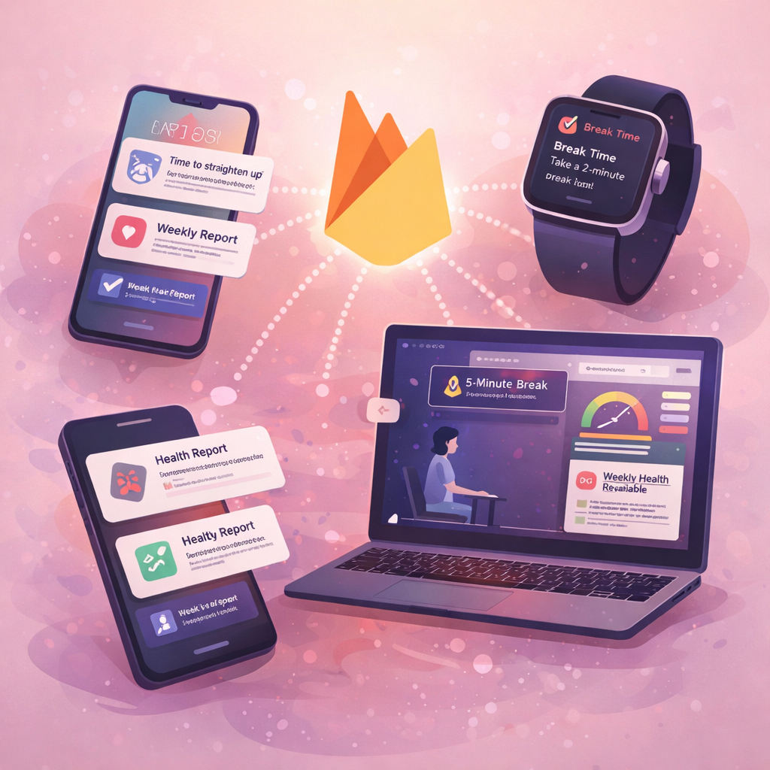

POWERED BY GOOGLE
Google Technology Stack
Firebase Authentication
Firebase Firestore
Firebase Cloud Messaging
Firebase Hosting
Secure user login with email, Google Sign-In, and multi-factor authentication for enterprise users.
Real-time NoSQL database storing posture data, analytics, and user preferences with automatic synchronization.
Push notifications for posture alerts, break reminders, and weekly health reports across all devices.
Fast, secure global CDN deployment ensuring low-latency access for users worldwide.
Prototype Link -: PostureAi

Slide 9
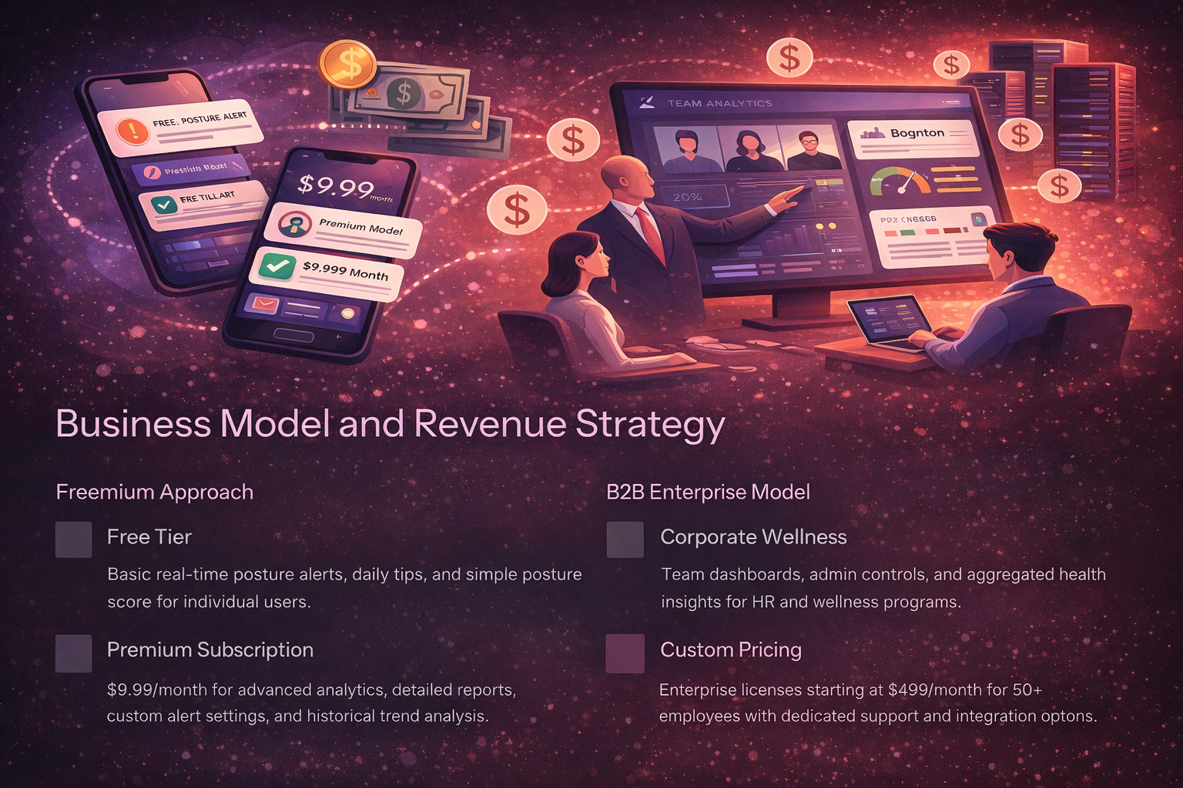
Business Model and Revenue Strategy
Freemium Approach
B2B Enterprise Model
Free Tier
Corporate Wellness
Basic real-time posture alerts, daily tips, and simple posture score for individual users.
Team dashboards, admin controls, and aggregated health insights for HR and wellness programs.
Premium Subscription
Custom Pricing
$9.99/month for advanced analytics, detailed reports, custom alert settings, and historical trend analysis.
Enterprise licenses starting at $499/month for 50+ employees with dedicated support and integration options.

Slide 10








IMPACT & FUTURE
Creating Healthier Work Environments
65%
40%
3x
Pain Reduction
Productivity Boost
Awareness Increase
Expected decrease in neck and back pain within 8 weeks of consistent use
Improved focus and efficiency from reduced discomfort and better energy levels
Users become more conscious of posture habits and ergonomic best practices
Future Roadmap
Mobile Apps
Wearable Integration
Native iOS and Android applications
Sync with smartwatches for continuous monitoring
Exercise AI
Enterprise Suite
Personalized stretching and strengthening routines
Advanced team analytics and wellness dashboards

Slide 11
